Slide 1
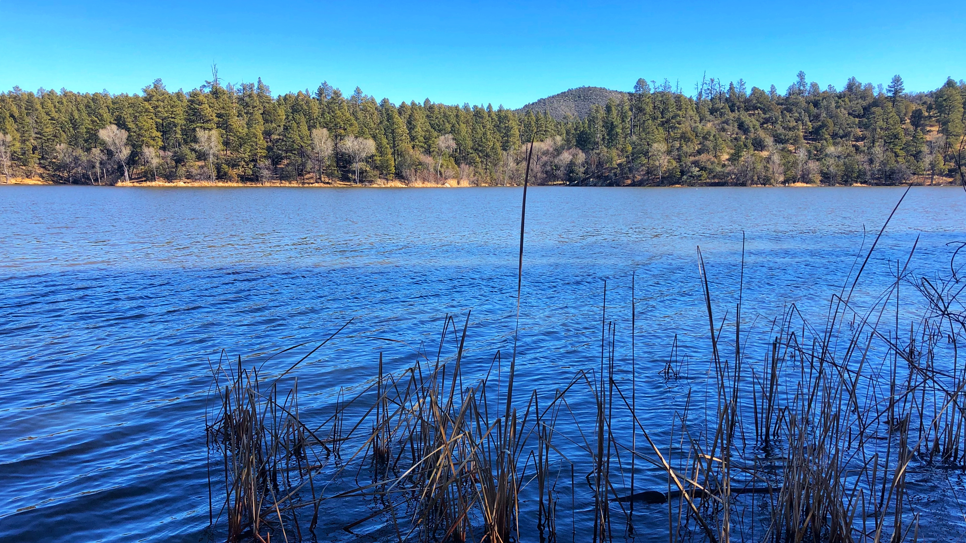
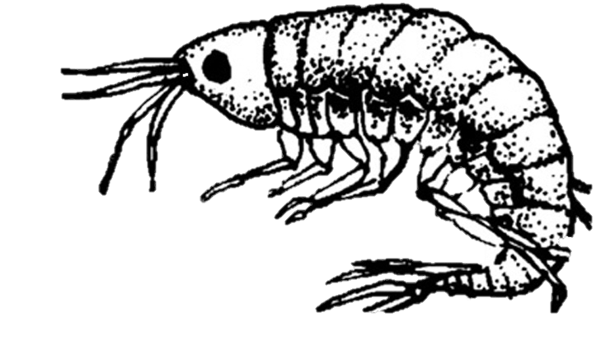



Variation in temperature tolerances in native and introduced amphipods of Northern Arizona, Hyalella azteca and Gammarus lacustris
Lauren Mason-Sarantopulos
Mentor: Dr. Rebecca Best
School of Earth and Sustainability
Northern Arizona University

Slide 2
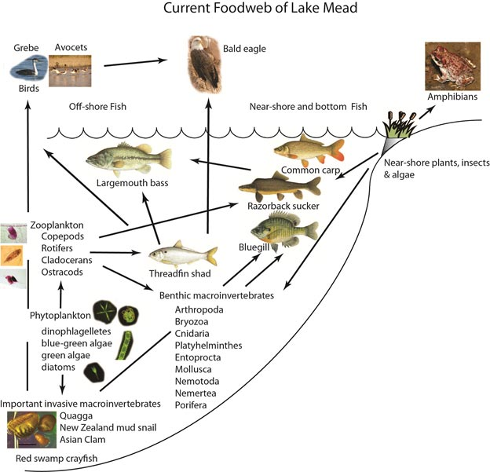
Freshwater Ecosystems in Arizona
Thousands of freshwater systems in Arizona
Rising water temperatures accelerated from climate change are stressors for aquatic life
Aquatic invertebrates, such as amphipods are important in aquatic food webs
livefins.com
nps.htm
Notes:
Freshwater systems in Arizona support hundreds of aquatic invertebrate species
Aquatic invertebrates are mesograzers that cycle nutrients through a system and are an important source of nourishment in aquatic food webs

Slide 3
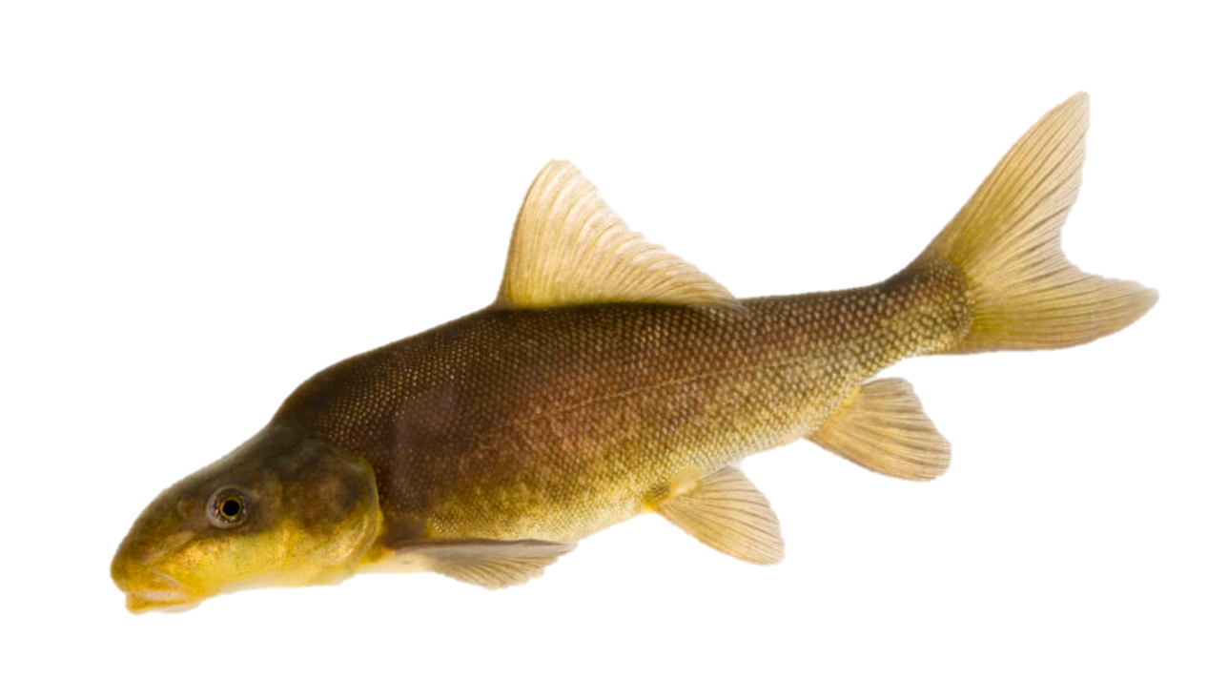
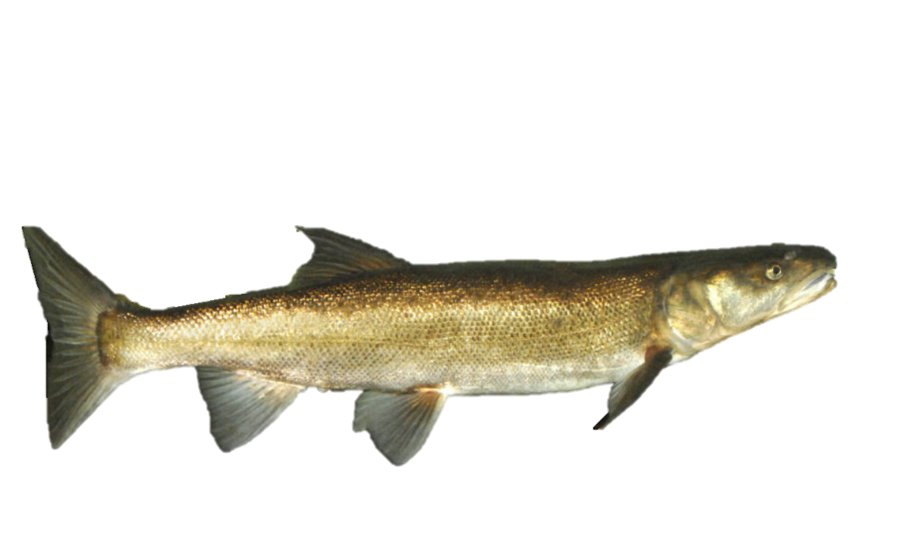
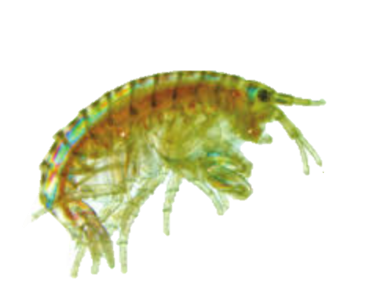
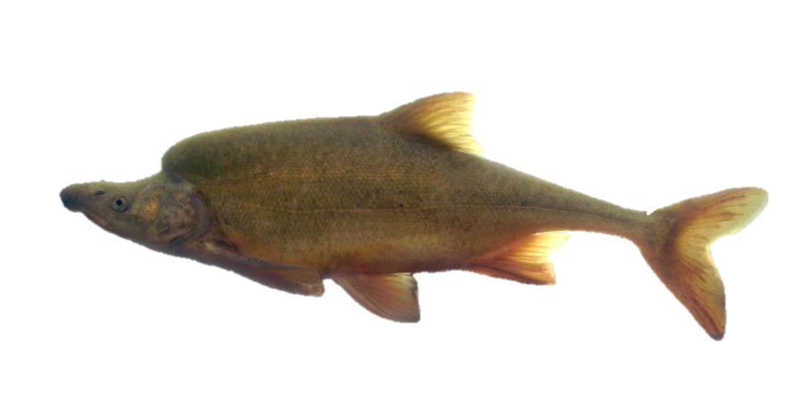
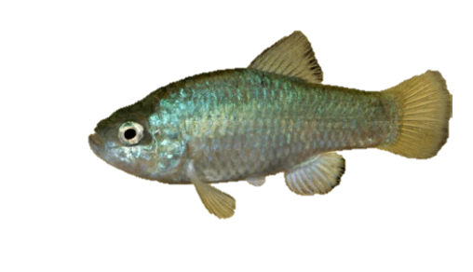
joelsart.com
inthecurrent.org
USGS.gov
USGS.gov
inthecurrent.org
*Not to scale
Notes:
Base of the food chain in many aquatic communities
Many endemic fish species
Humpback Chub- endangered (Glen Canyon Dam specimens found to mostly eat Gammarus)
Razorback sucker- endangered
Desert Pupfish
Colorado Pikeminnow

Slide 4
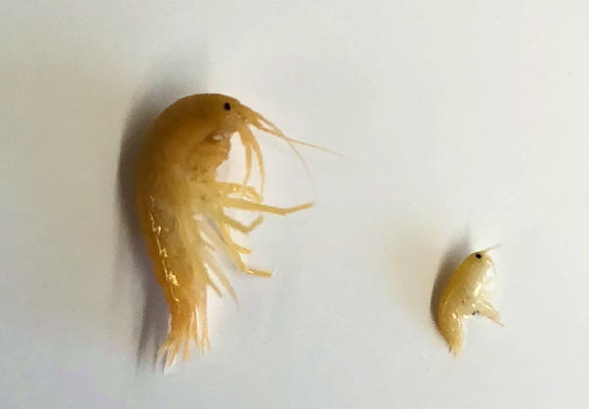
Gammarus lacustris
Introduced species in AZ between 1967-1968
12-18 mm long at maturity
Survives at or below 20°C
Restricted habitat
Hyalella azteca
Native species in AZ
4-8 mm long at maturity
Survives at 10°C - 33.5°C
Lives in a wide range of habitats
12mm
5mm
Notes:
Hyallela used as an indicator of ecosystem health because of sensitivities to water quality
Can survive at high and low elevations
Used to test toxicity of freshwater

Slide 5
Objectives
1) Compare distribution across species in Northern Arizona
2) Determine whether Hyalella is found across a broader range of temperature, dissolved oxygen, pH, nitrate levels
3) Use lab experiments to see whether amphipods’ short term responses to individual stressors are consistent with their field distributions
Notes:
Hyalella azteca is a native amphipod to Arizona waters, with exposure to a wide range of Arizona’s water quality variables, and long-term isolation between populations. In contrast, Gammarus lacustris is a recent introduction to a narrower range of to Arizona waterbodies. Therefore, I hypothesize that Hyalella will show less sensitivity than Gammarus to varying temperatures and heightened nitrate levels found in the field and will be found across a greater range of these variables. In the lab, Hyalella will also exhibit higher resilience than Gammarus to manipulated temperature and nitrate levels.

Slide 6
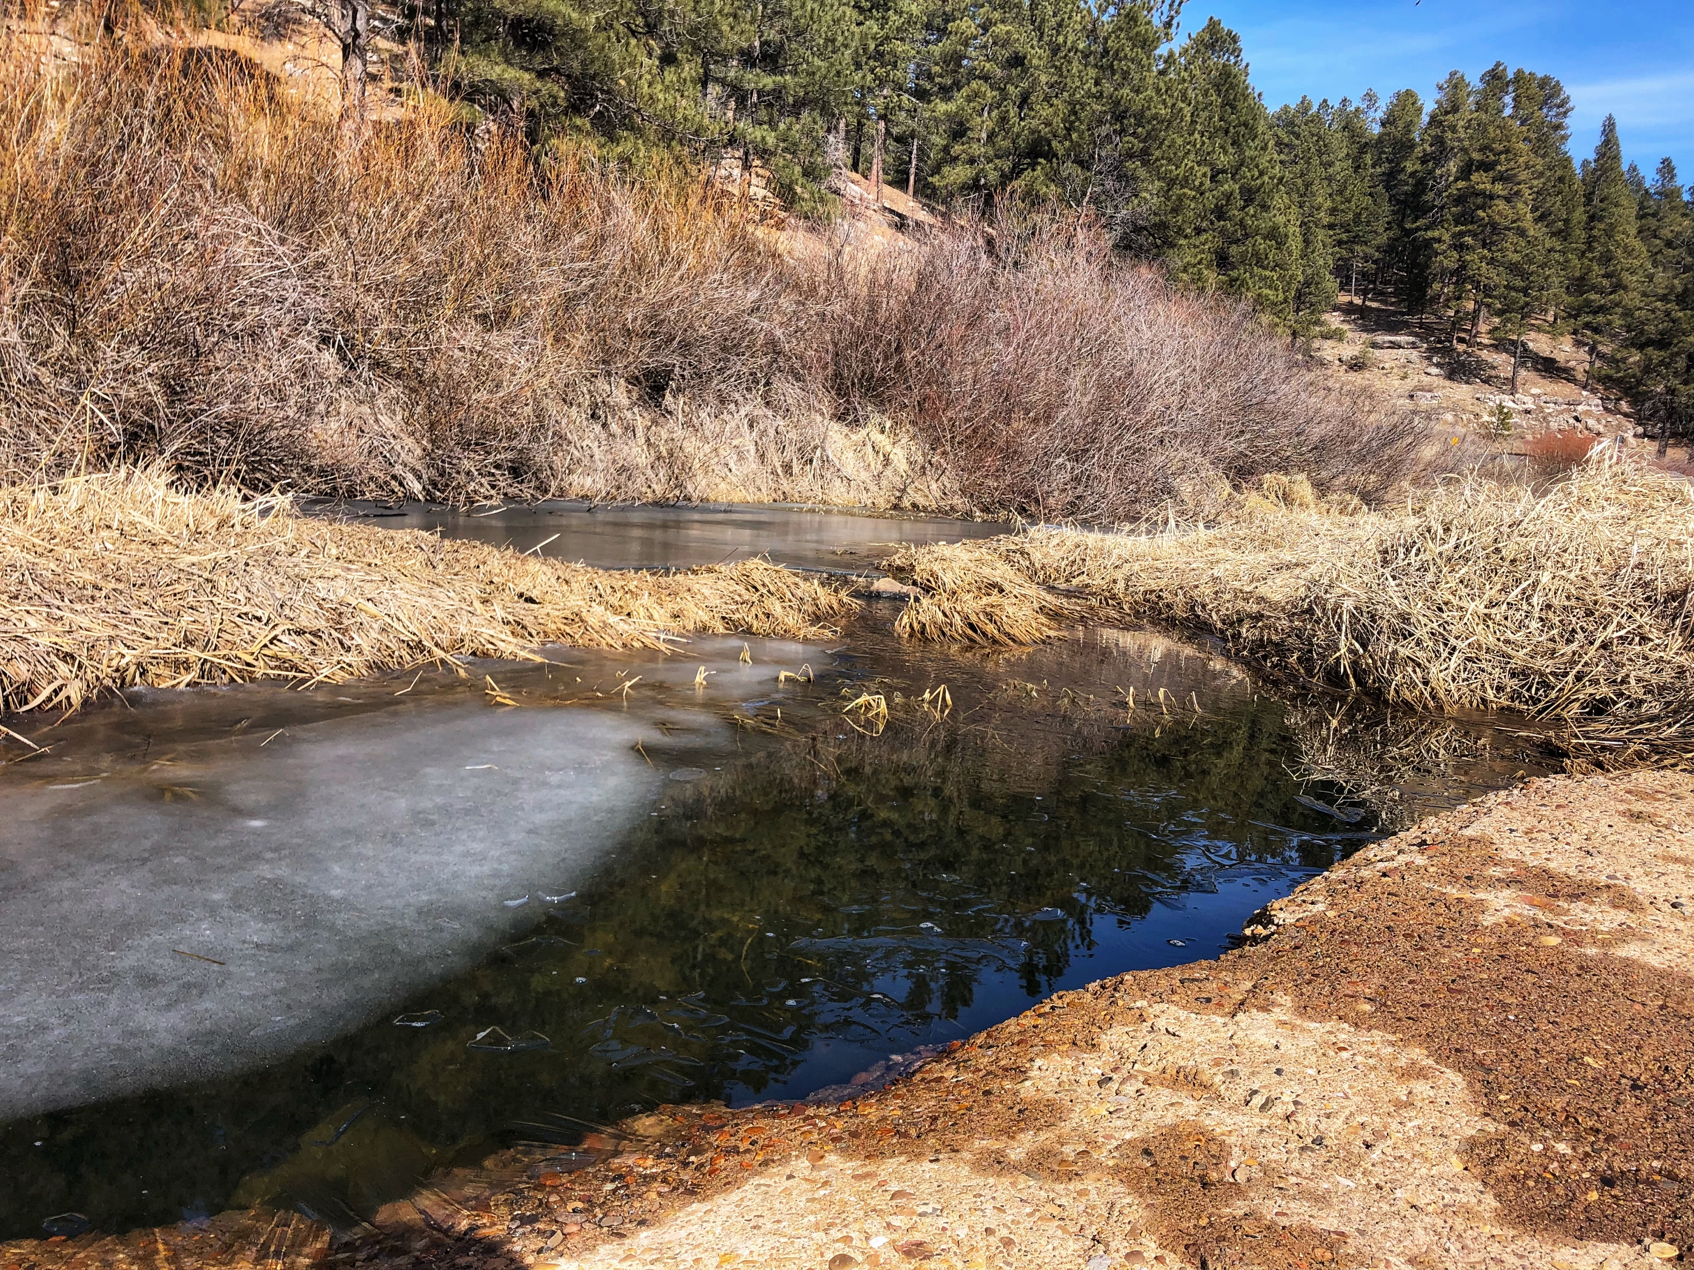
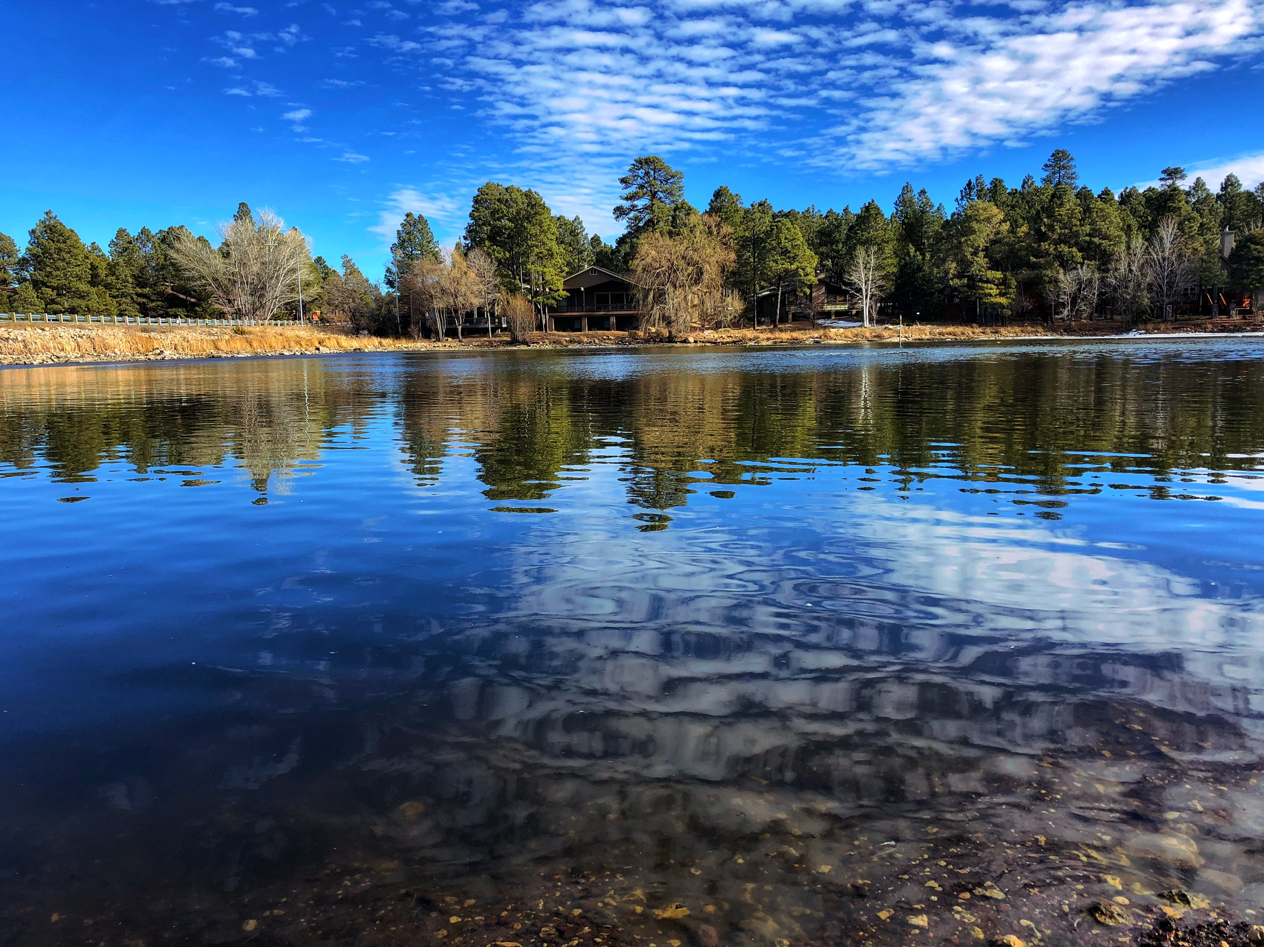
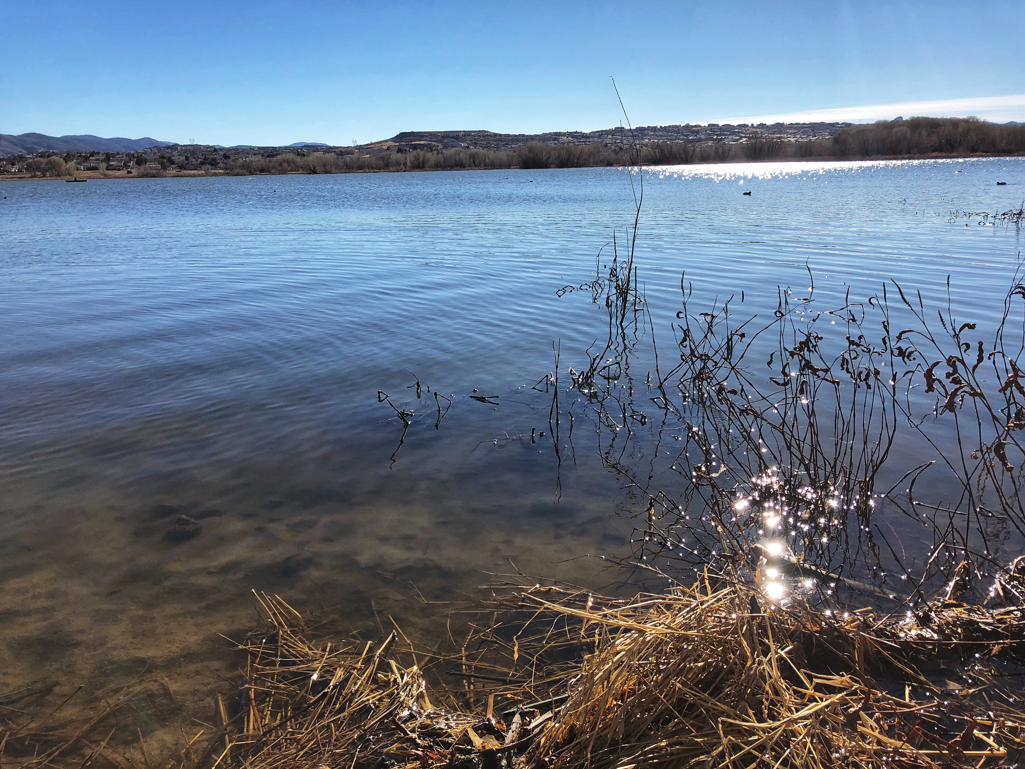
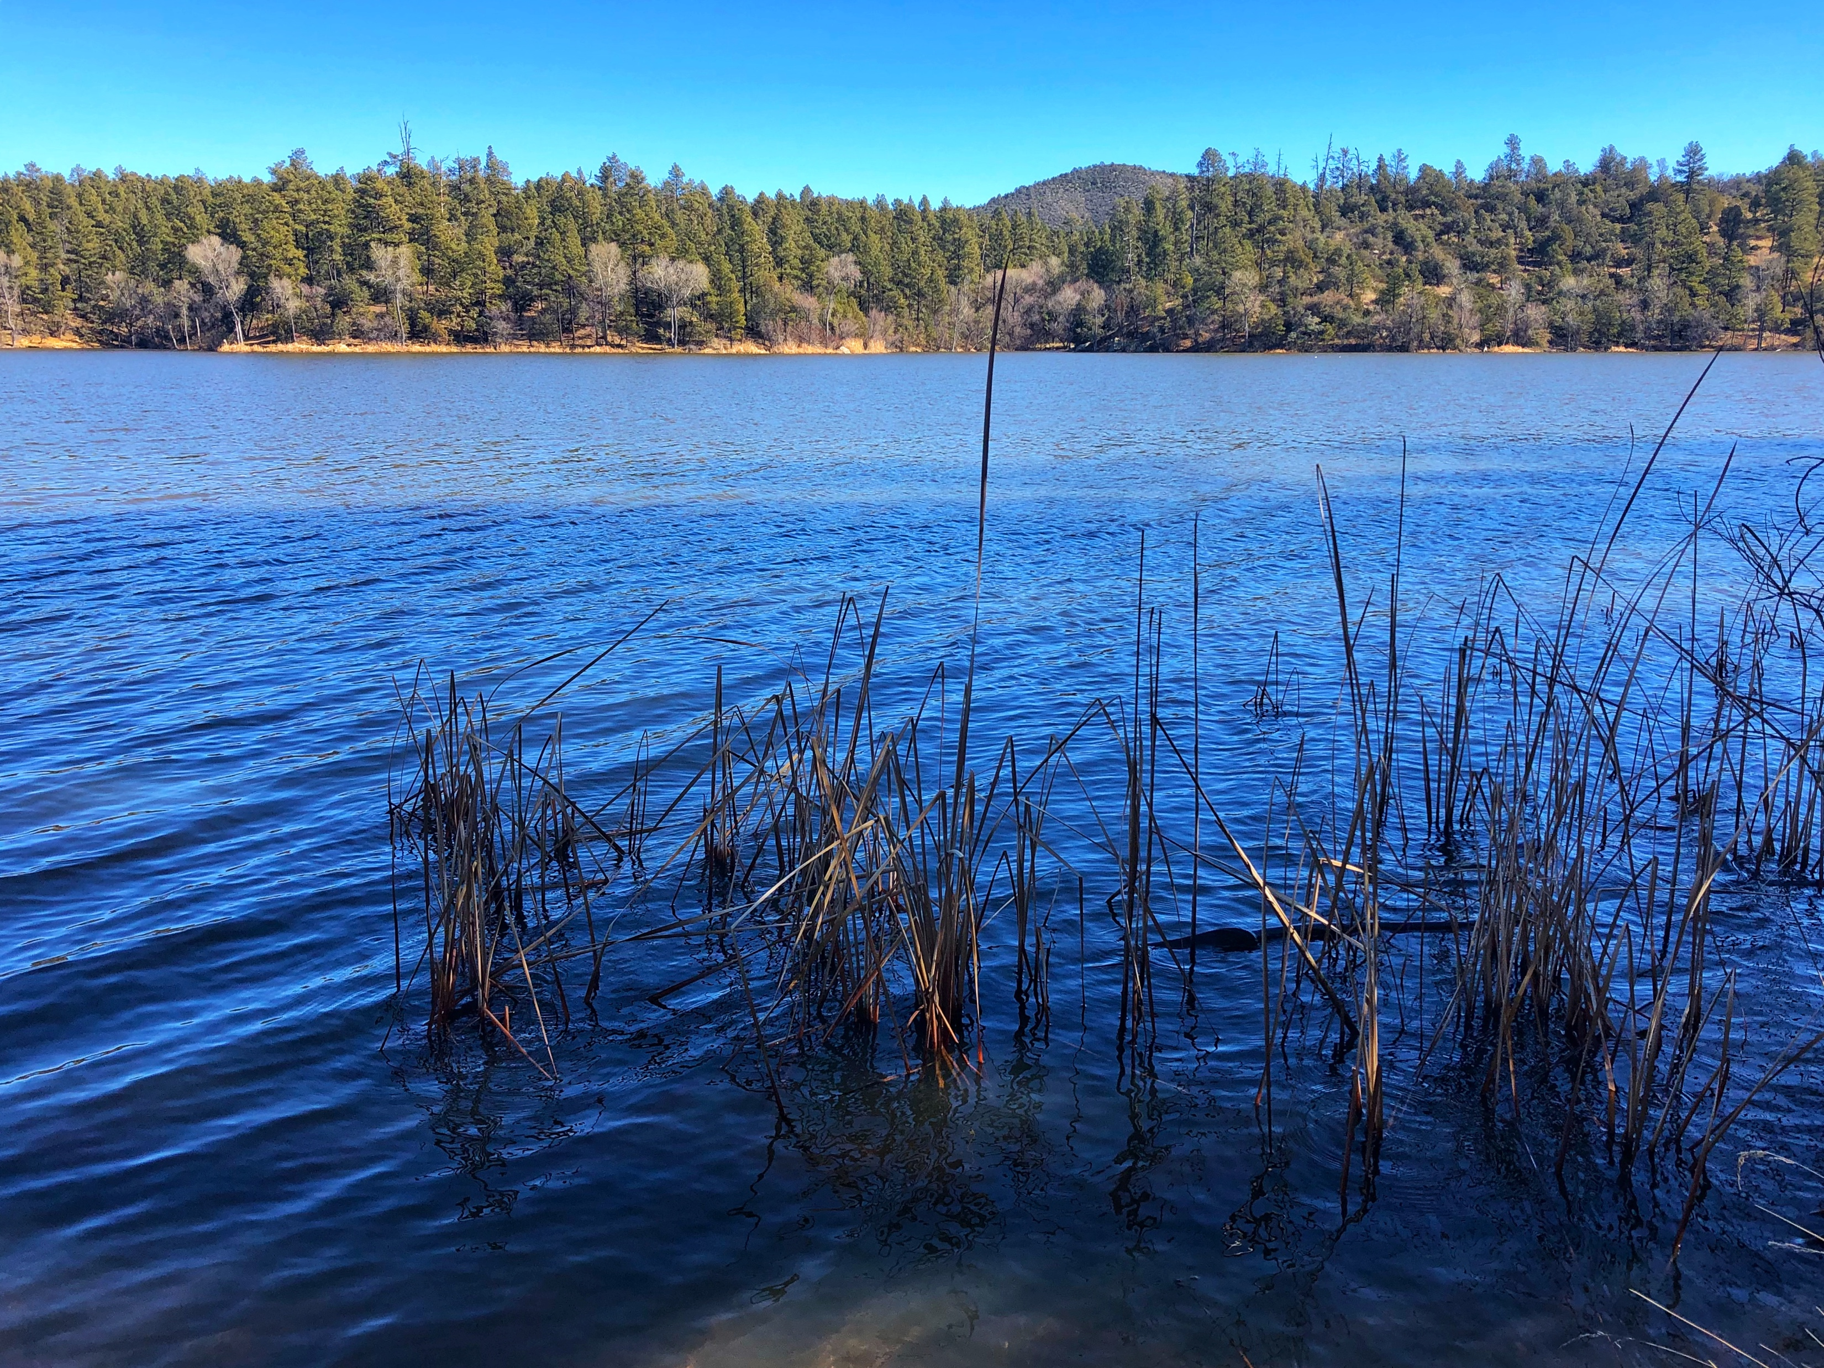
Water bodies
Sites
Upper Lake Mary (Coconino)
White Horse Lake (Coconino)
Duck Lake (Coconino)
Lake Elaine (Coconino)
Dow Spring (Coconino)
Ashurst Lake (Coconino)
Humphrey Lake (Coconino)
Marshall Lake (Coconino)
Shultz Lake (Coconino)
Lilly Pond (Coconino)
Kachina Wetlands (Coconino)
Log Landing (Coconino)
Pumphouse Wash (Coconino)
Lynx Lake (Yavapai)
Willow Lake (Yavapai)
Goldwater Lake (Yavapai)
16 sites visited in Northern AZ
  Across Coconino and Yavapai county
Pumphouse Wash
Humphrey Lake
Goldwater Lake
Lynx Lake

Slide 7
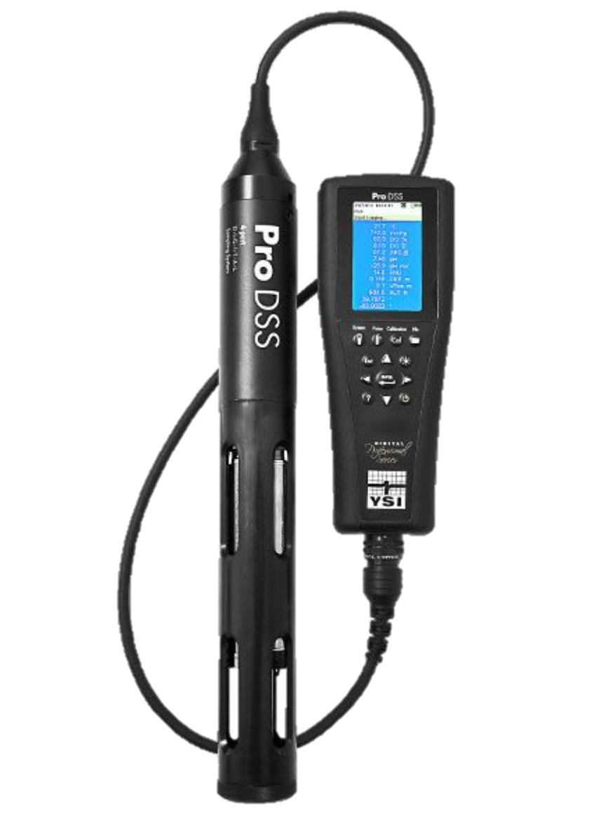
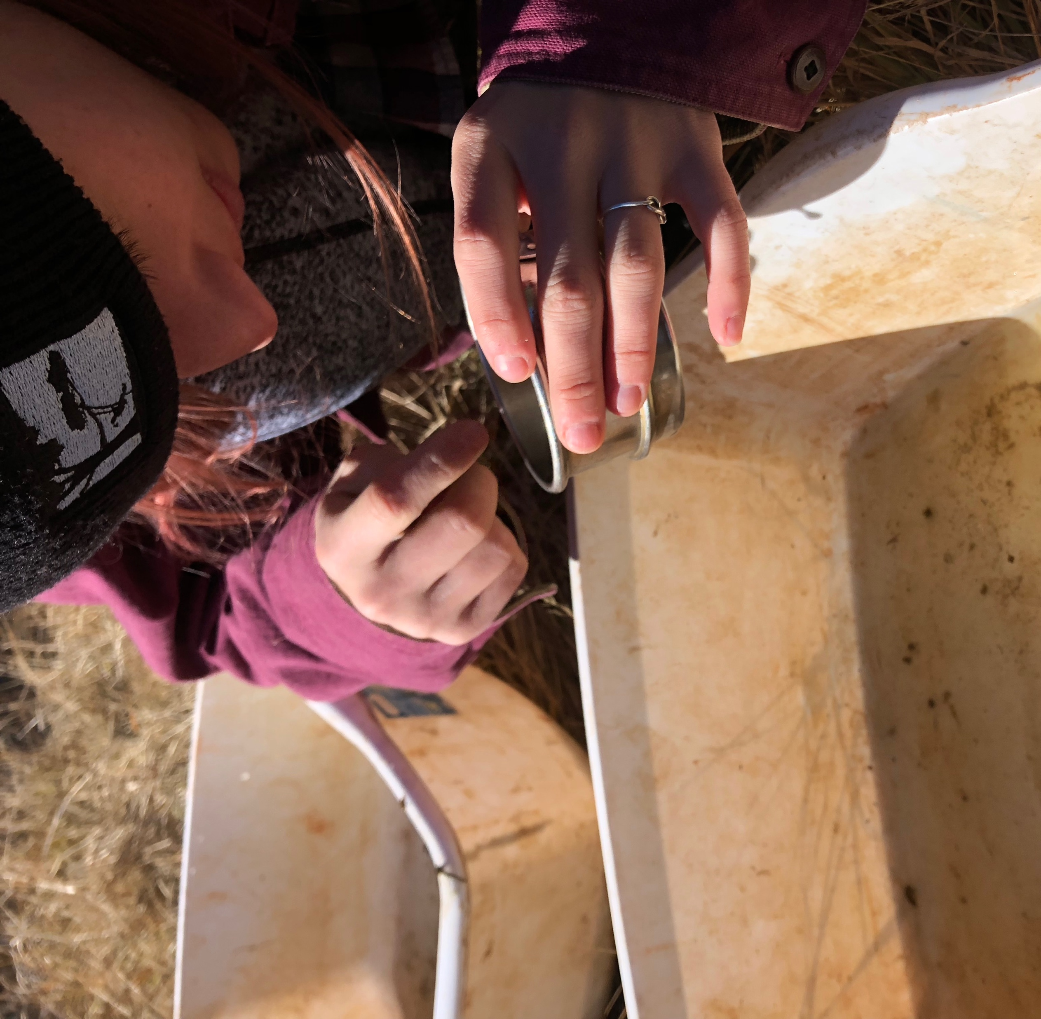
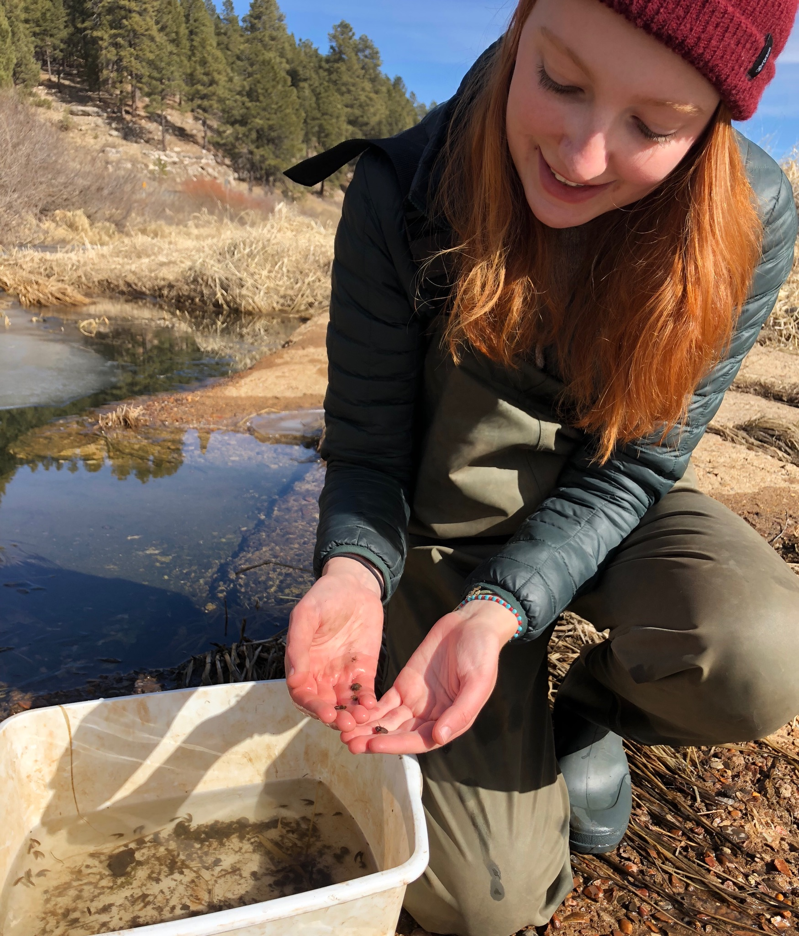
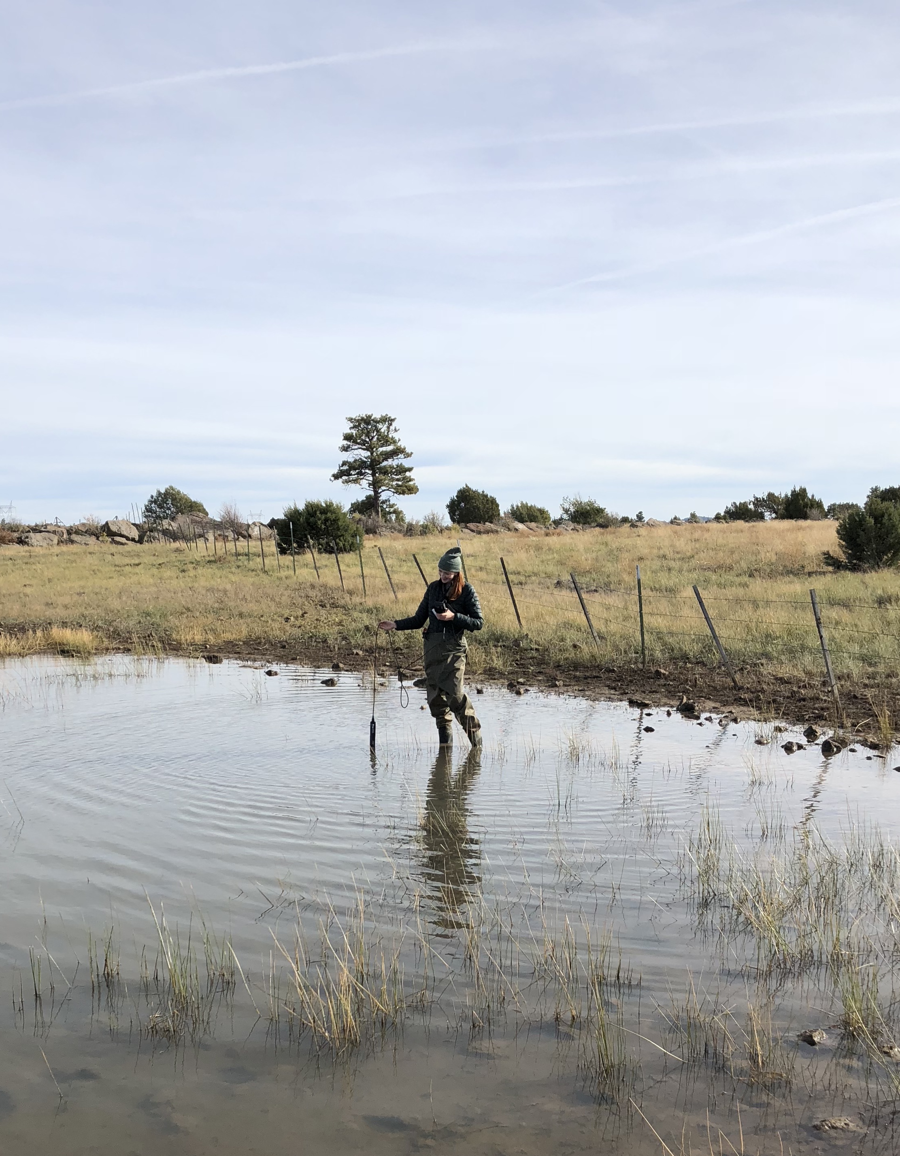
Amphipod and Water Parameter Collection
YSI Probe and pH probe used to check dissolved oxygen, temperature, nitrate levels, and pH
Sweep with D-net to collect amphipods
fondriest.com
Notes:
4 different spots were taken
D-net sweep to collect amphipods
If found, amphipods were sorted out form other biodiversity for transport back to the lab

Slide 8
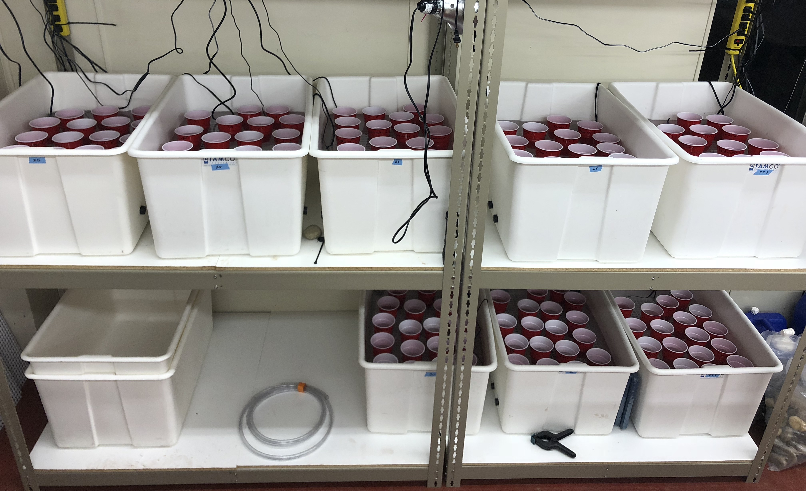
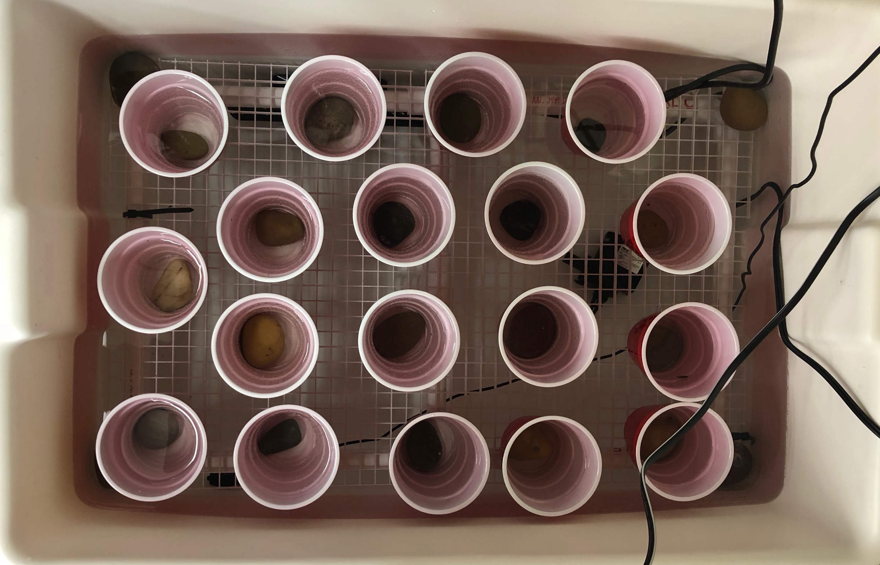
Lab Trials
20°C
27.5°C
25°C
30°C
25°C
4 temperature treatments, 8 tanks
  20°C (control) , 25°C , 27.5°C , 30°C
6 cups for each population
  2 amphipods in each cup
Amphipods checked every 12 hours
  Trials conclude at 96 hours
30°C
27.5°C
20°C
25°C tank
Humphrey Lake
Lynx Lake
Goldwater Lake
Watson Lake
Pumphouse Wash
Lilly Pond
Notes:
8, 20 gallon fish tanks held water baths
Six cups for each population divided across the 8 tanks (6 cups for each population)
Recorded how many amphipods were still alive at each 12 hour mark

Slide 9

Results
Notes:
Notes to self
Don’t say temperature fluctuation, just variation of temperature across locations

Slide 10
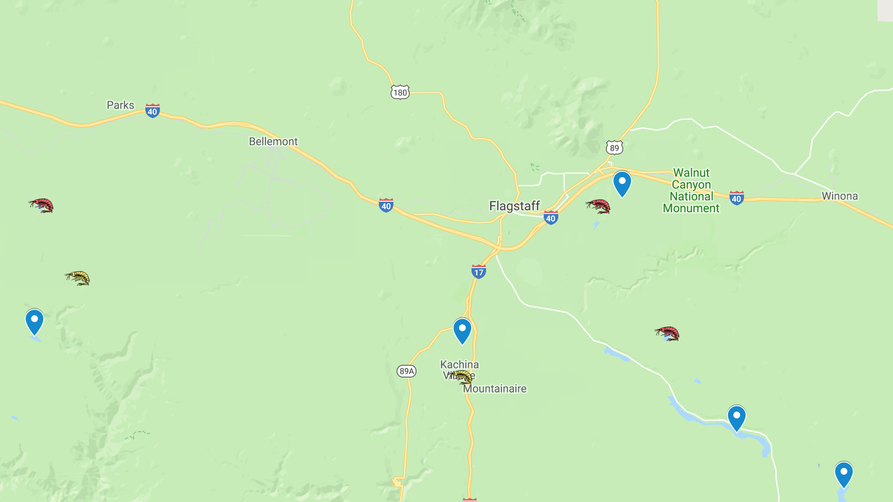

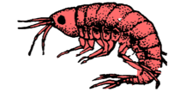

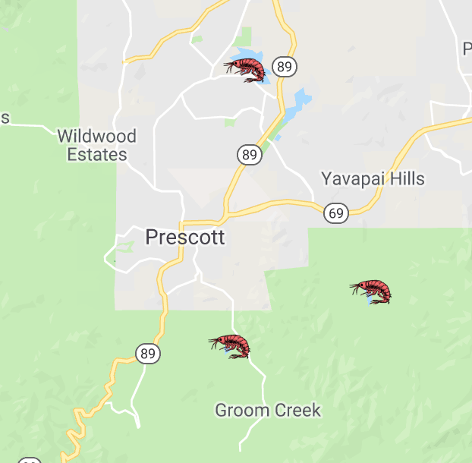
Hyalella found across more sites than Gammarus
  8/16 sites show Hyalella, 50%
  2/16 sites show Gammarus, 12%
Neither species
Hyalella
Both species
(Hyalella and Gammarus)
Notes:
Hyallela found at Humphrey Lake, Marshal Lake, Scholz Lake, Lynx Lake, Willow Lake, and Goldwater Lake
Both species (Hyallela and Gammarus) found at Lilly Pond and Pumphouse wash

Slide 11
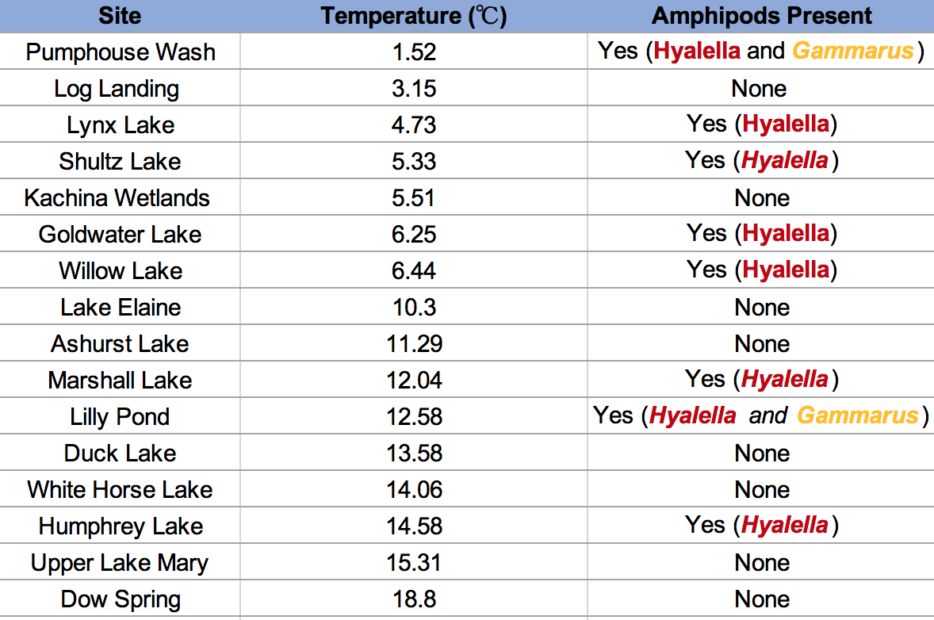
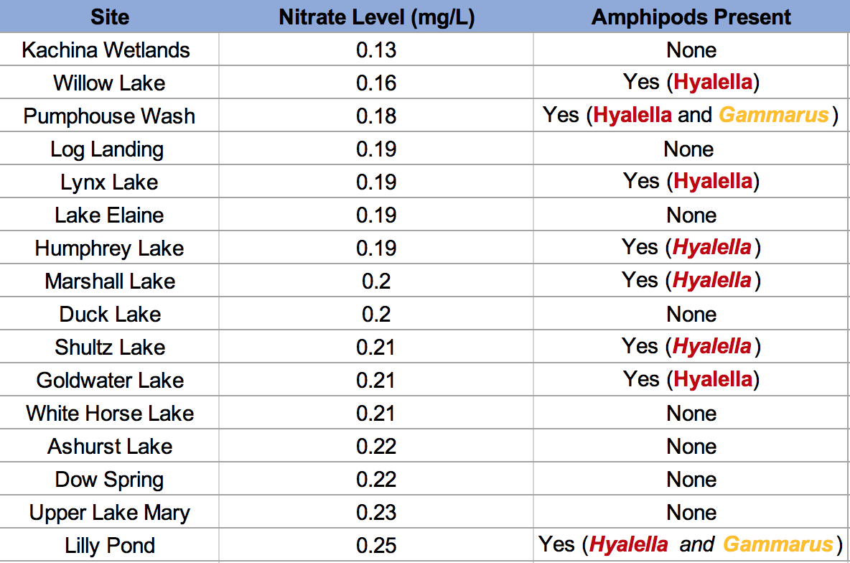
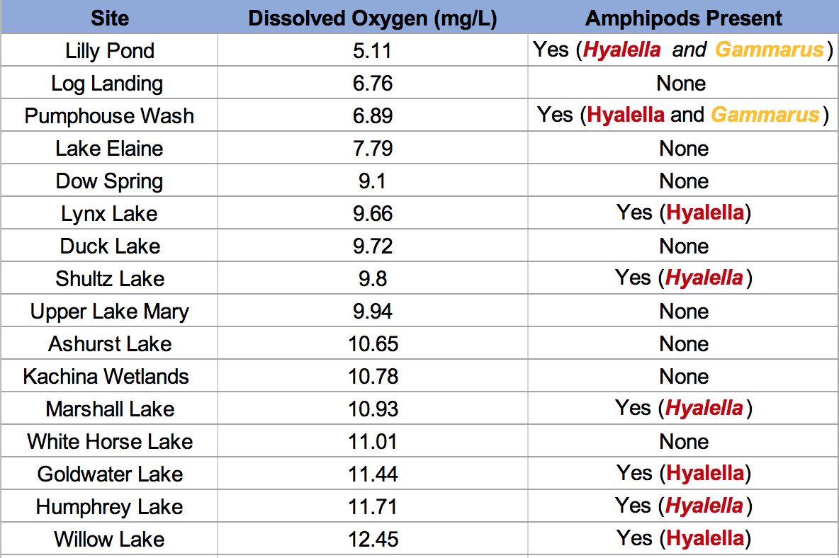
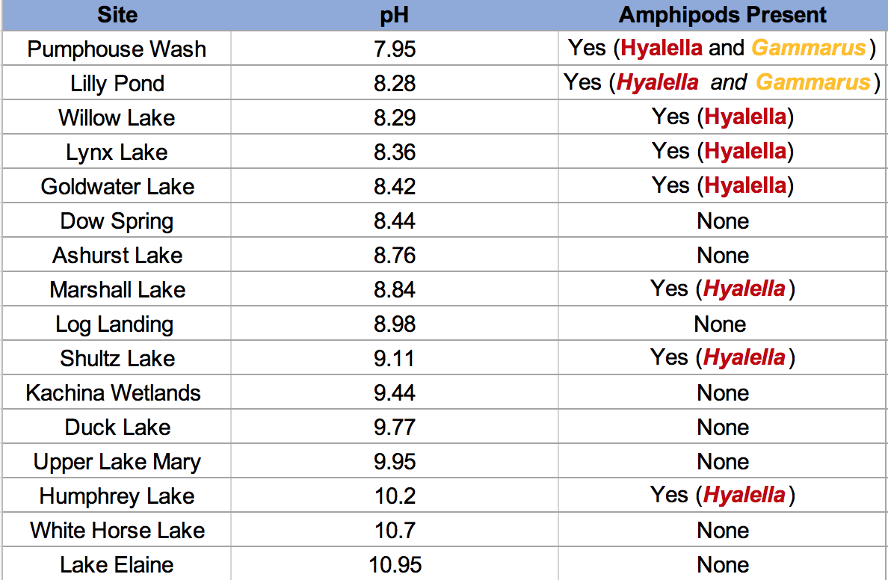

Slide 12
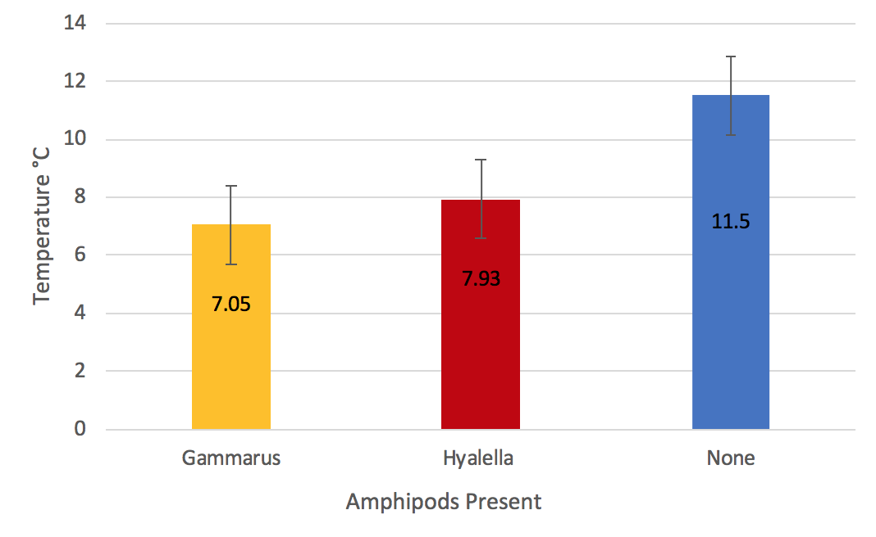
*Error bars account for one standard error
Notes:
Standard error: a measure of statistical accuracy of an estimate

Slide 13
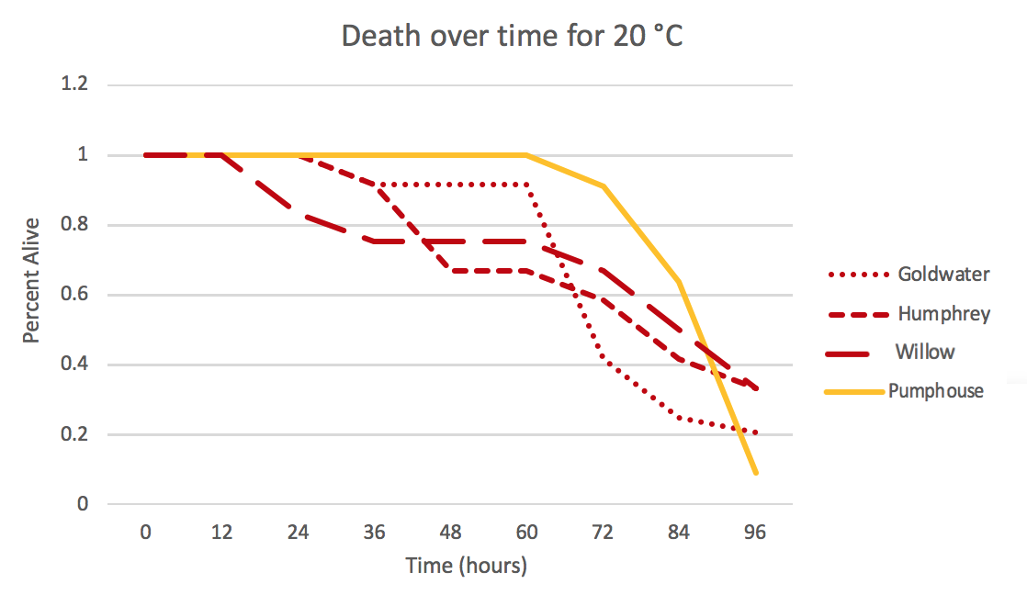
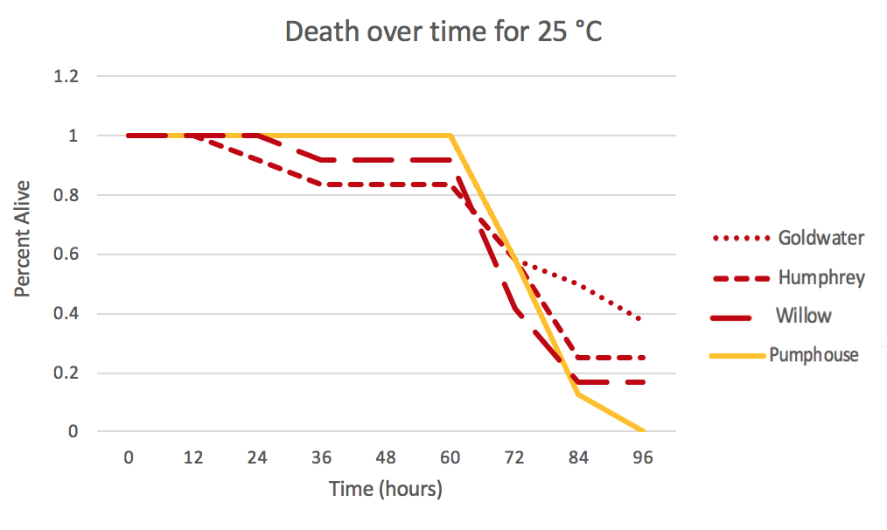
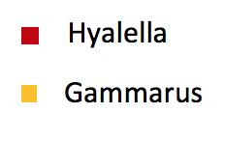
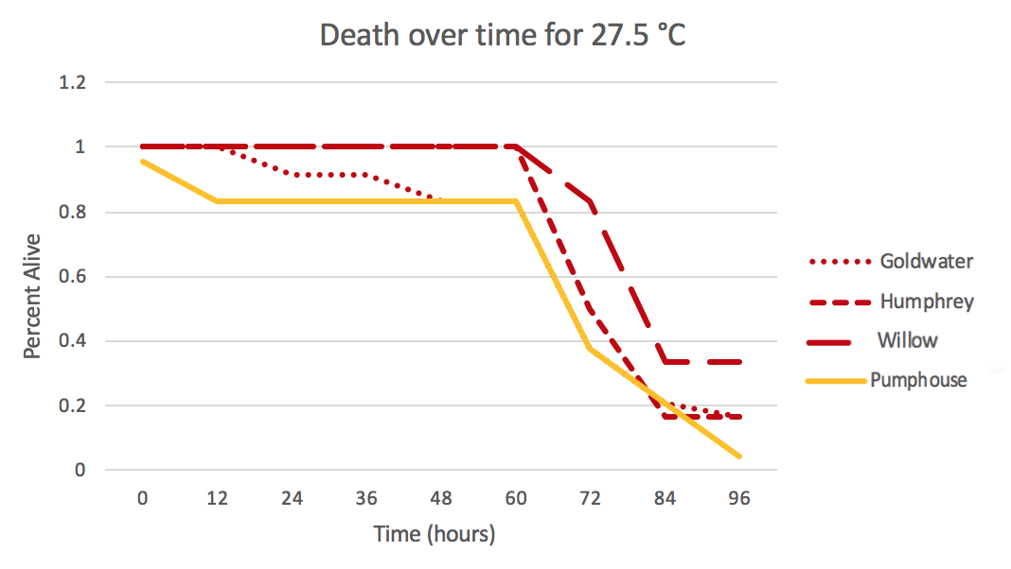
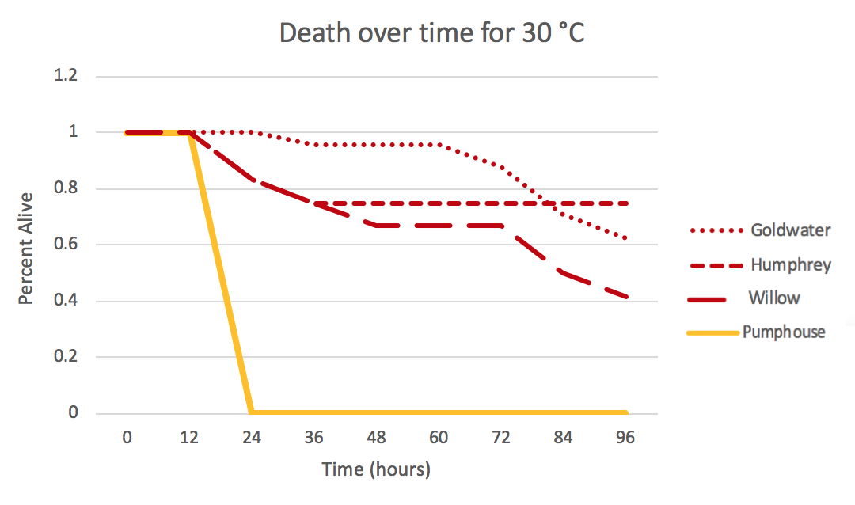

Slide 14
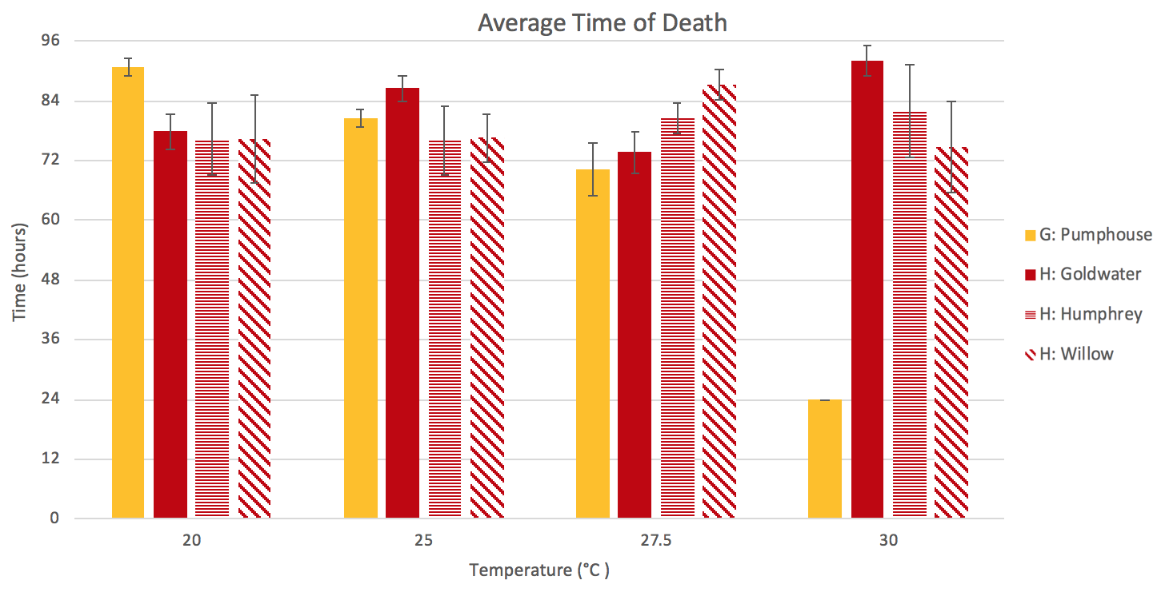
*Error bars account for one standard error
P<0.0001 for temp x population

Slide 15
Conclusions
No significant difference found in field distribution of Hyalella vs. Gammarus
Gammarus sensitive to temperatures above 27.5 °C
Overall, native Hyalella more resilient to rising temperatures than Gammarus
Hyalella most likely continue to persist as waters warm, and will continue to serve as a food source for organisms such as fish
Notes:
Add some significance stuff

Slide 16
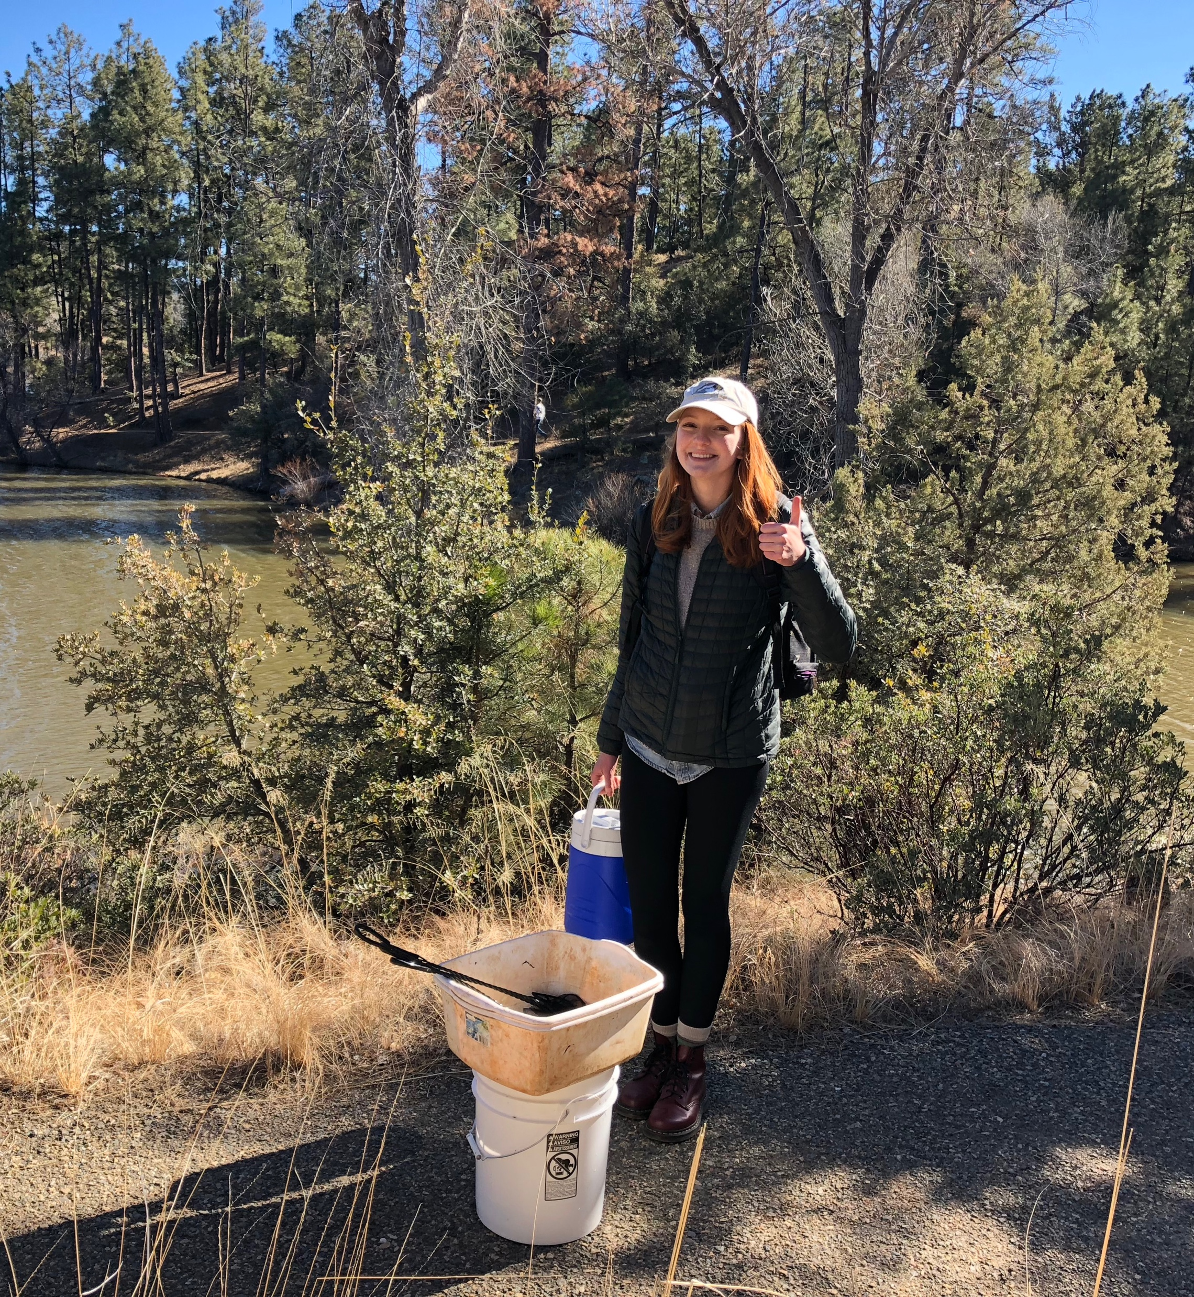
Thank you!
Special thanks to…
Northern Arizona University
Hooper Undergrad Research Award
NASA Space Grant Consortium
Dr. Rebecca Best
Dr. Becky Beresic-Perrins
Aibhlin Ryan, Morgan Andrews, Joshua Rihs, Todd and Michelle Sarantopulos, and everyone who lent a hand in the field or lab!

Slide 17
Questions?

